Slide 1
Cultures in india
By: Yashkumar Shah

Slide 2
Table of Contest
Gujarat
Panjab
South Bangol

Slide 3
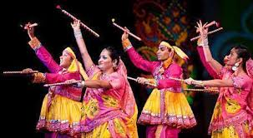
Gujarat
Garba

Slide 4
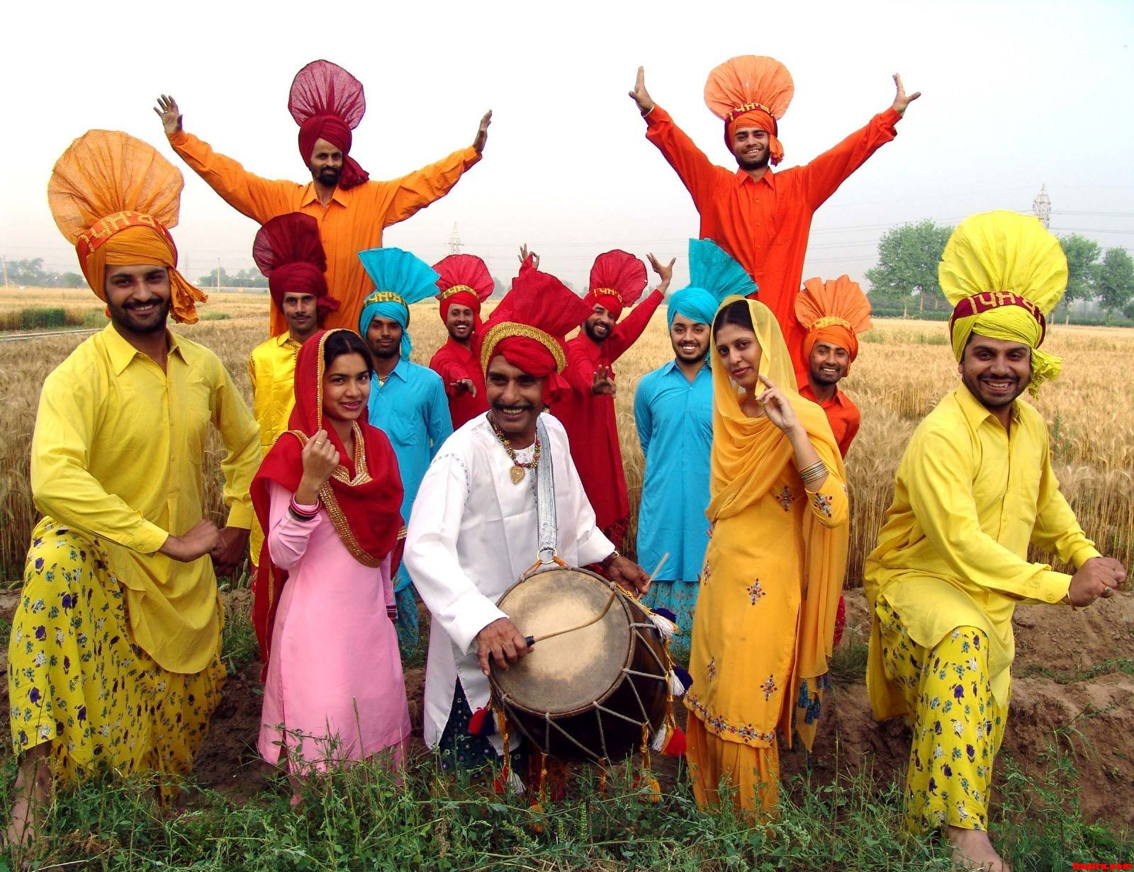
Panjab
Pangla

Slide 5
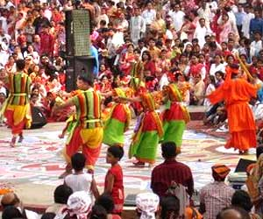
South Bangol
Dance

